Slide 1
8.2 Fixed Spanning Sets, Orthonormality, and Projections

Slide 2
The fundamental principles of unsupervised learning all lie in some very rudimentary ideas from linear algebra combined with the cost-function based approach to learning we have seen previously with supervised methods.
This is because unsupervised learning is about effectively representing datasets with no output, i.e., only input data.
Our goal with such data is simply to effectively represent it, and this is a task that has roots in the notion of a spanning set of vectors from basic linear algebra.

Slide 3
In this Section we review the fundamental concepts from linear algebra surrounding the notion of a spanning set of vectors.
This includes: linear independence, learning proper weights for a fixed basis set representation, orthogonal bases and representation, and projections.
Reviewing these topics up front will allow us to much more effectively tackle and intuit unsupervised learning techniques since they can be thought of as direct extensions.

Slide 4
Perfectly representing data via a fixed spanning set

Slide 5
Remember when thinking about data points in a multi-dimensional vector space, we can think of them simultaneously as 'dots' (as shown in the left panel) or as 'arrows' (as in the middle panel below).
When thinking about spanning sets of vectors it is often helpful to visualize points in the same space using both of these conventions - i.e., some as 'dots' and others as 'arrows' as shown in the right panel.

Slide 6
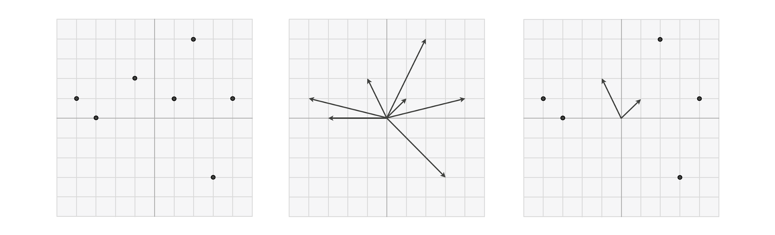

Slide 7
Those vectors drawn as arrows are particular points - often called a basis or spanning set of vectors - over which we aim to efficiently represent every other point in the space.
Those other vectors shown as dots are those points we wish to represent over our basis / spanning set.

Slide 8
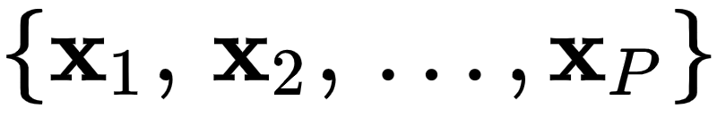
Let’s suppose our set of input points - our dataset - is written as and lives in N dimensions (that is, each point is N dimensional).
Moreover throughout we will assume that our dataset has been mean-centered - a simple and completely reversible operation that involves subtracting off the mean of the dataset along each input dimension - so that it straddles the origin.
This sort of normalization is almost always done in practice, and is computationally inexpensive to execute.

Slide 9
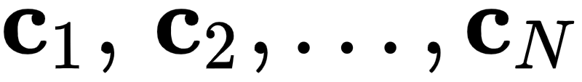
In order for our basis / spanning set to be capable of perfectly representing all P of our points it too must live in the same N dimensional space.
For a candidate basis / spanning set to be capable of perfectly representing such generic N dimensional (input) data means...
...that for each data point a set of weights exists so that, in particular linear combination, our basis set can match each data point as

Slide 10
Technically speaking in order for this possibility to exist our spanning set must be linearly independent
that is, the spanning vectors do not 'overlap', they point in completely different directions in the space.

Slide 11
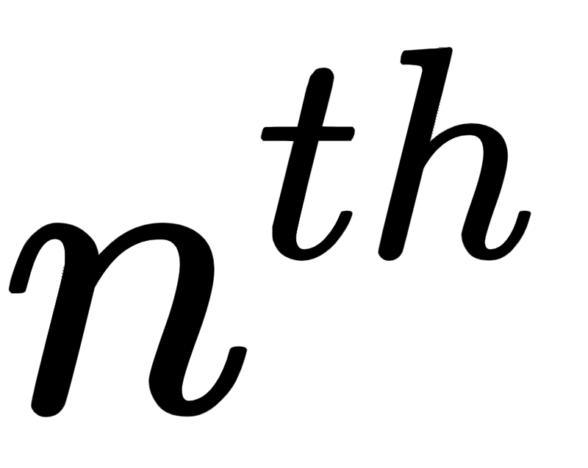
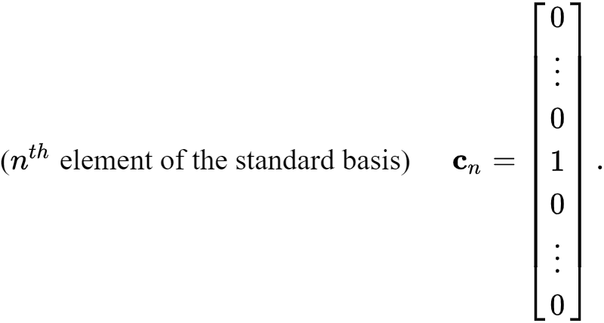
As the simplest example imagine our spanning set was the set of N standard basis vectors. The element of a standard basis takes the form of vectors that consist entirely of zeros, except for a 1 in its slot

Slide 12
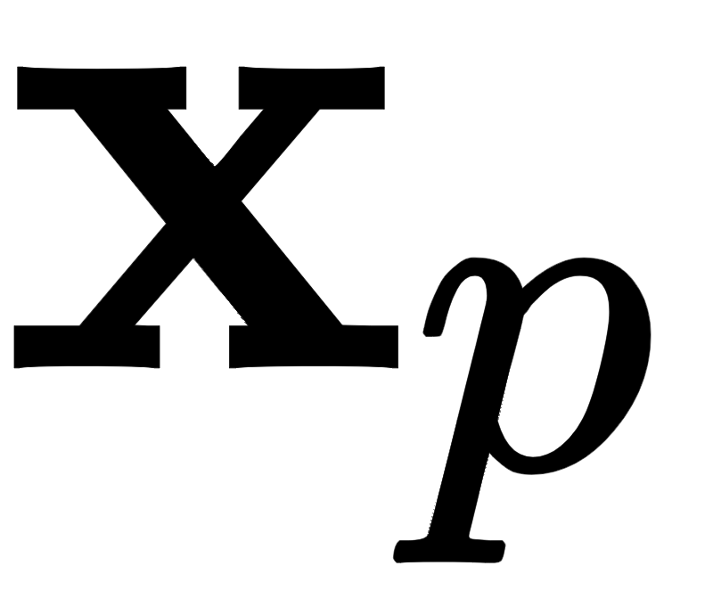
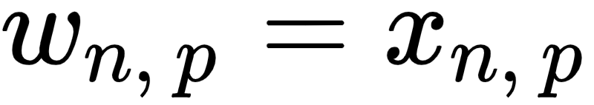
To represent a data point over the standard basis is a trivial affair, and one can easily check that the perfect weights must be defined as
i.e., each weight is simply equal to the value of the data point we aim to represent.
For most any other spanning set however these weights must be solved for numerically, which we frame in terms of a cost function minimization after the examples below.

Slide 13
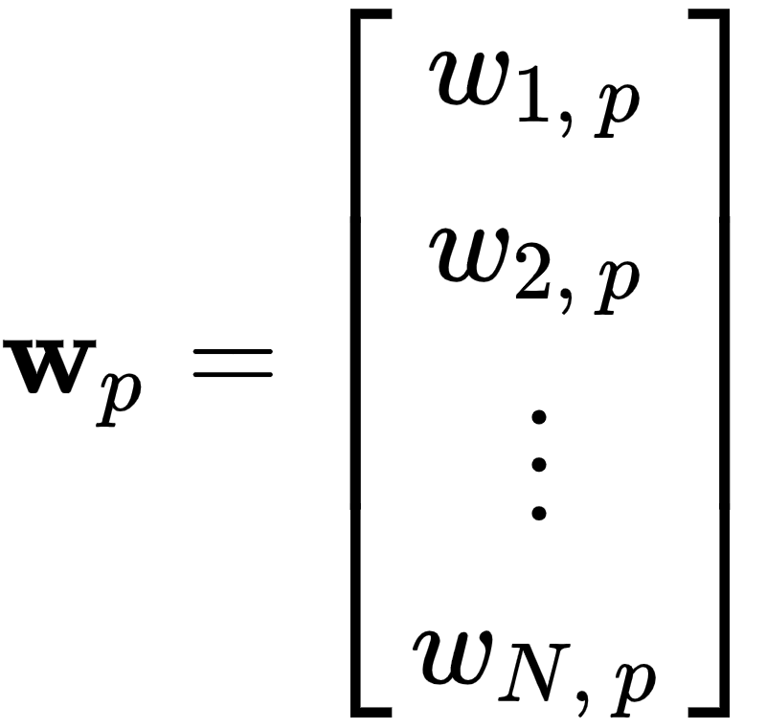
If indeed the spanning set of vectors is linearly independent, then having properly tuned the weights of point , denoted as the N length vector
This weight set provides the new representation of with respect to the spanning set.

Slide 14
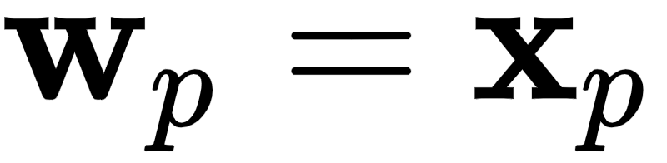
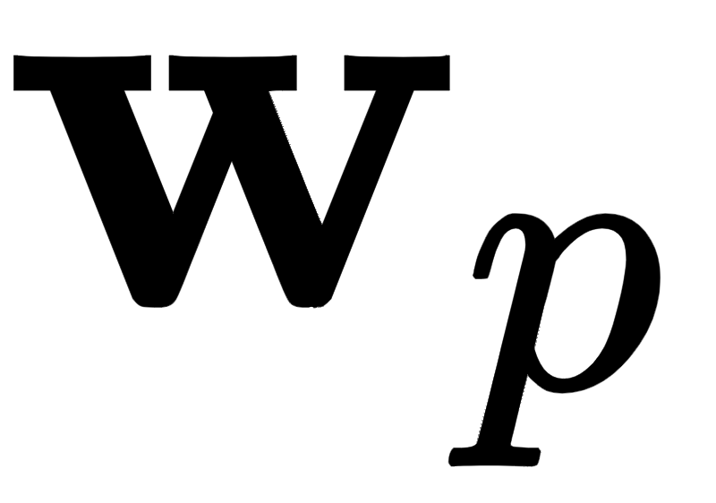
For example, in the trivial case where our spanning set consists of the standard basis our representation or feature vector is the data point itself!
Otherwise - typically referred to as the new encoding of in the transformed feature space whose coordinate axes are defined by the spanning set - is a vector that differs from original data point.

Slide 15
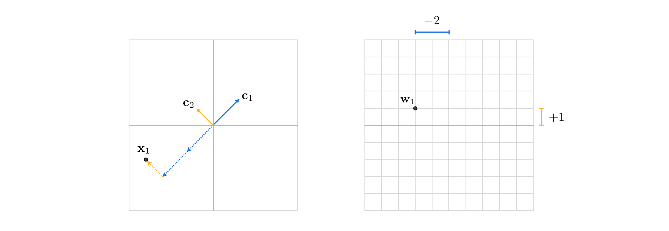
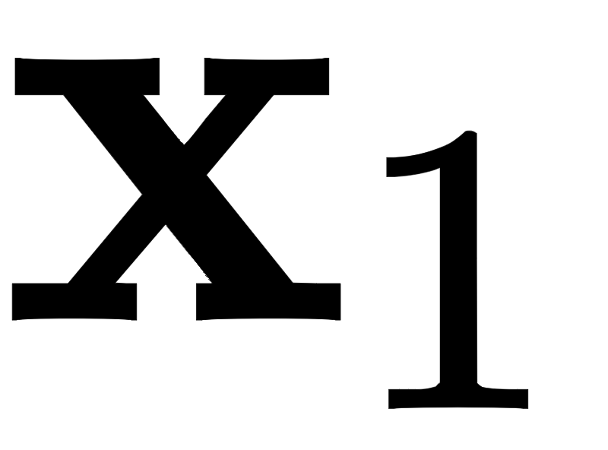
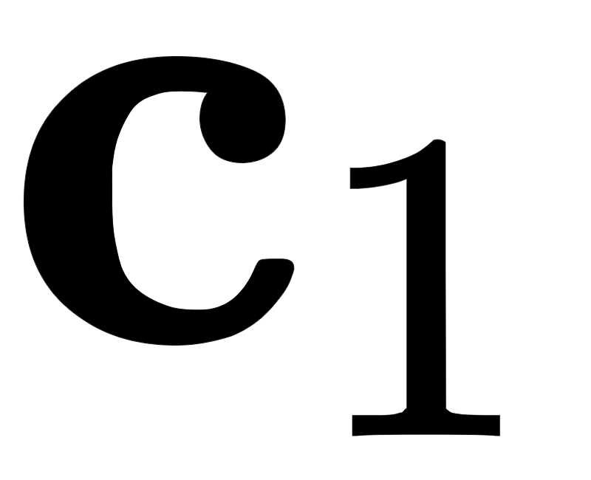
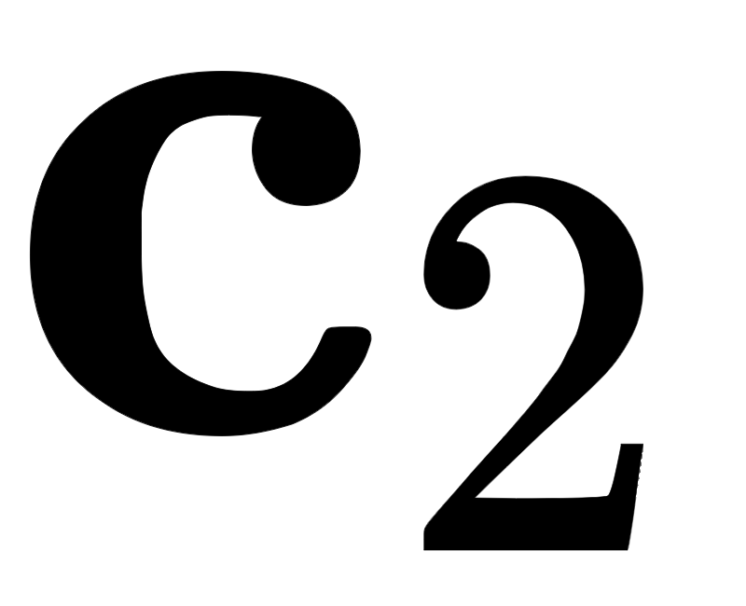
(left) A 2-d point, , shown in the space spanned by vectors and . (right) Representation, also known as the encoding, of in the transformed feature space.

Slide 16
Perfect representation with complete spanning set in N=2 dimensions

Slide 17
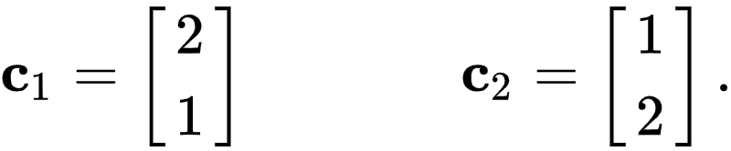
Lets examine an example of a spanning set of vectors in N=2 dimensions.
Below we run an animation showing how the set of two spanning vectors

Slide 18

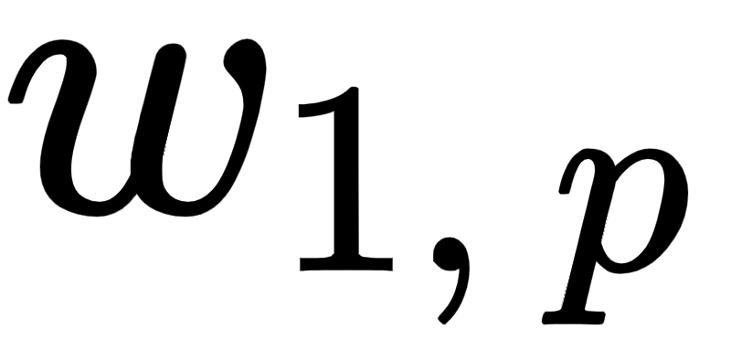
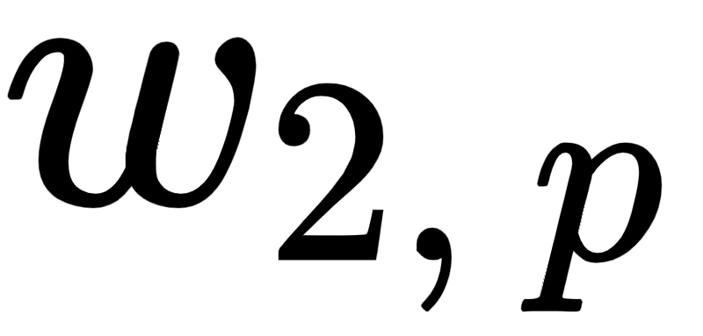
Because these two vectors are linearly independent.
That is they do not overlap completely and point in different directions in the space, we can perfectly represent any point in the space using some linear combination of them as
Here the weights and are unique to each point .

Slide 19
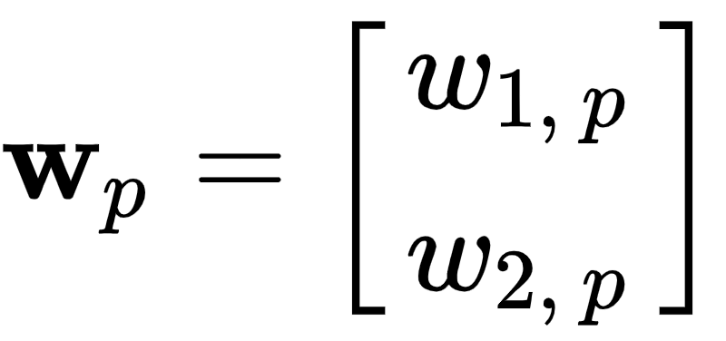
Once properly tuned the weight vector provides us with a new representation or encoding of in the transformed feature space whose coordinates are precisely our spanning set.
In the animation below we range show two panels - the original space in the left, and the transformed feature space in the right defined by the above spanning set.
In each panel the two spanning set vectors and are shown as solid black arrows, and points (taken over a course range of the input space here) are shown as black dots.

Slide 20
Each point is shown simultaneously in the original and transformed feature space, where the point is encoded by its weight vector
In each space the appropriate linear combination of the two spanning vectors required to represent the point is shown as a red arrow, and each scaled spanning vector is shown as a blue arrow.
As the slider is pushed from left to right additional points additional points are shown represented over the spanning set / encoded points in the transformed feature space.

Slide 21
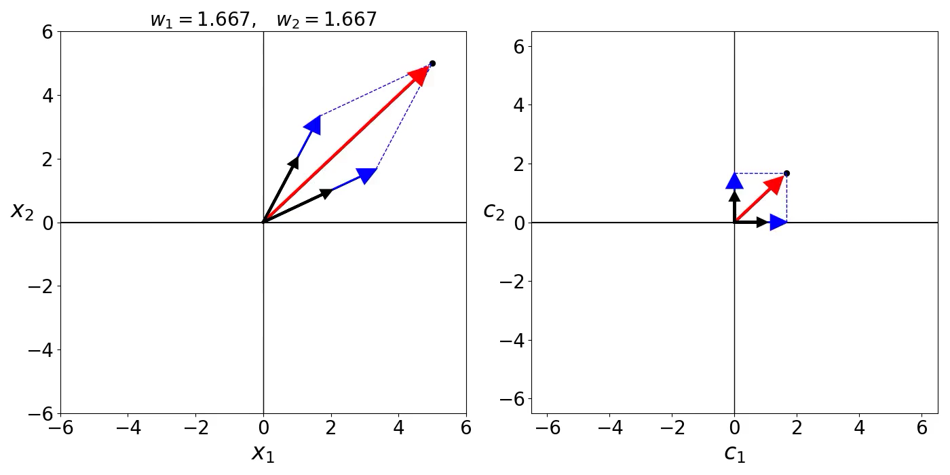

Slide 22
Below we show how this spanning set transforms a prototypical dataset of 50 data points.

Slide 23
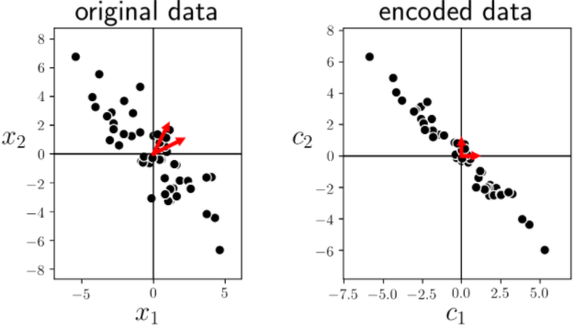

Slide 24
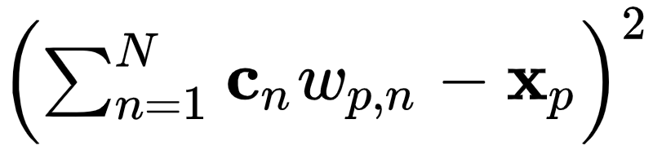
One way we can solve for the proper weights is by setting up / minimizing an appropriate cost function.
It is natural (as in our development of e.g., linear regression) to square the difference between both sides of equation (1) as
We then tune the corresponding weights to make this squared error as small as possible.

Slide 25
So for each data point we have a cost function
When minimized appropriately provides us with a proper set of parameters for representing over the spanning set.
While we could certainly use an iterative method like gradient descent to minimize this single-point cost, here we can in fact directly setup and solve the [first order system]of equations.

Slide 26
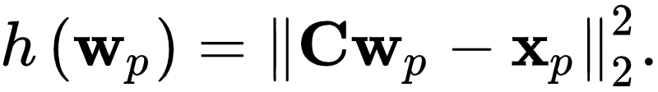
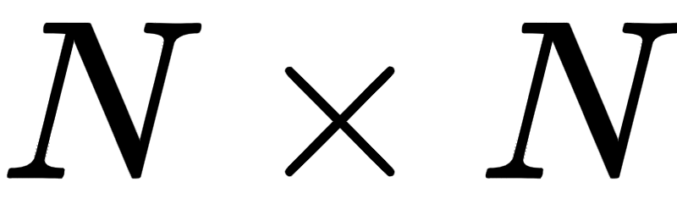

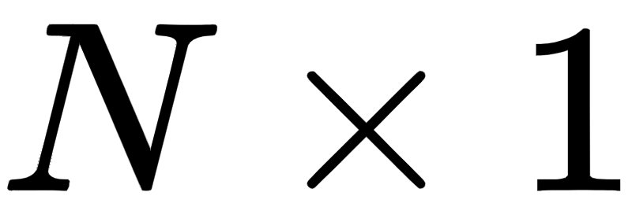
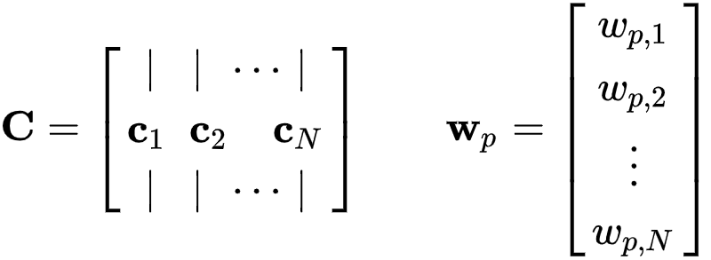
It is perhaps easiest to see this by writing the above cost function more compactly as
Here the matrix is formed by stacking the spanning set vectors column-wise, and the vectors as

Slide 27
Now setting the gradient of the cost function to zero and solving for gives the linear symmetric system of equations for each
which we can conveniently write algebraically as

Slide 28
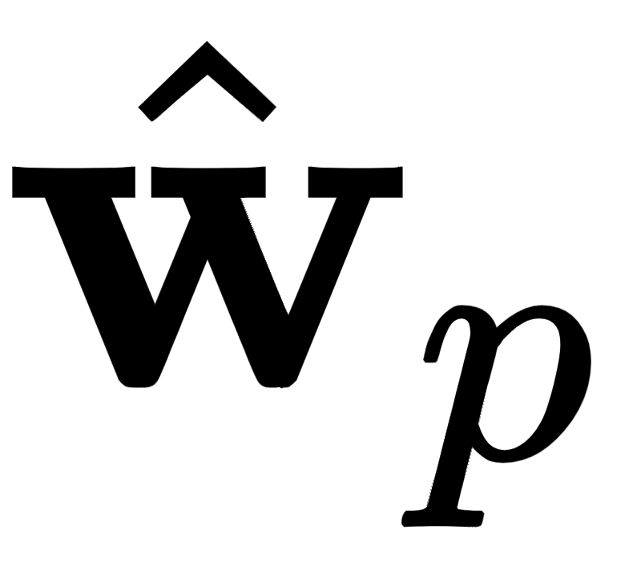

Numerically this sort of symmetric system of equations can be solved via e.g., coordinate descent.
Once these are solved for - and we have our learned weights - we can then perfectly represent a point over the spanning set as we desired in equation (1) as

Slide 29
Notice here that we can take the average of the individual single-point cost functions in equation (4) / (5), giving a cost function over the entire dataset
This is just a convenient way of writing out the entire list of P single-point cost functions together
i.e., we get no new solution methods by doing this, as the joint cost decomposes over the weight vectors .

Slide 30
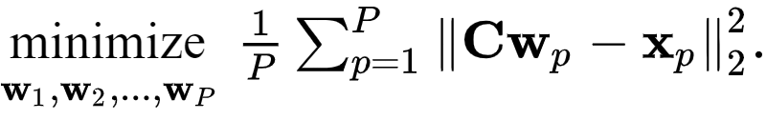
Formally then our optimization problem to recover all of the proper weight vectors can be expressed as

Slide 31
Perfect representation using a fixed orthonormal spanning set

Slide 32
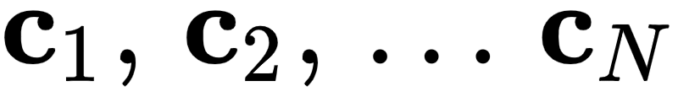
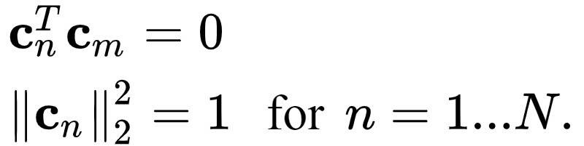
A very special kind of basis / spanning set one often sees when representing data points is one whose elements are perpendicular and unit length.
Such a spanning set is one that spans an entire space, but whose elements are perpendicular have length one.
Algebraically this is written as

Slide 33
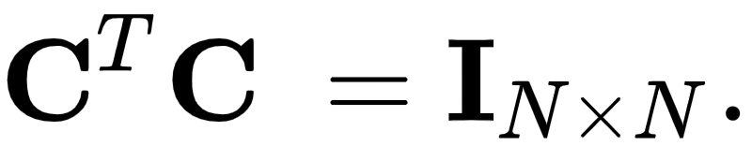
Note that the same constraints expressed in terms of the concatenated basis matrix can be written compactly as
Often such a spanning sets are likewise referred to as orthonormal or - sometimes - orthogonal
Technically speaking the latter term should only be applied when a set of vectors consists of perpendicular elements that are not necessarily unit-length, it is unfortunately often used to refer to unit-length perpendicular vectors as well.

Slide 34
Example: Standard basis

Slide 35
The standard basis discussed above the most common example of an orthogonal basis - one whose elements are perpendicular and are unit-length.
In the next cell we show a fine range of linear combinations of the standard basis in N=2 dimensions.
As with any spanning set / basis, linear combinations of these two vectors can perfectly represent any point in the space.

Slide 36
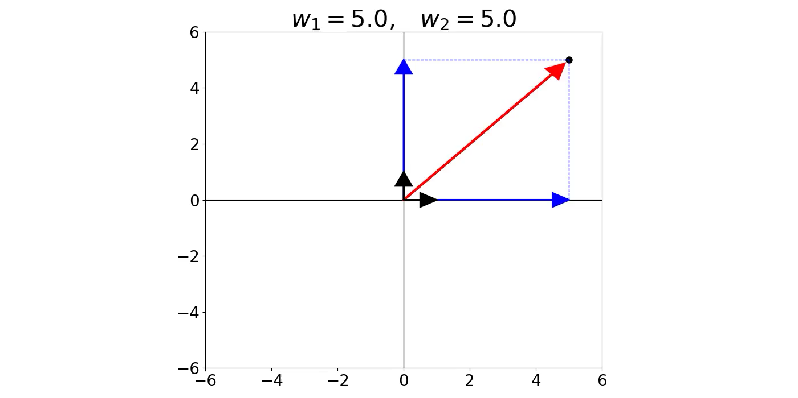

Slide 37

Lets express the particular weights over which a dataset of P points is represented over an orthonormal basis.
Thus the "system of equations" providing the ideal weight vector or encoding or each data point over an orthonormal basis of vectors is given simply by

Slide 38
In other words, if a basis / spanning set is orthonormal there is no system of equations left to solve for - we get the solution / encoded version of each point directly as a simple inner product of the spanning set against each data point!
Practically speaking this means that computing the weight vector or encoding of a point is considerably cheaper if our spanning set is orthonormal.

Slide 39
Note further how here how we can - with these ideal weights solved for - express our data representation over an orthonormal spanning set in equation (1) very nicely in vector / matrix notation as
So in short, when the spanning set is orthonormal the entire set of encodings of a dataset can be expressed strictly in terms of the spanning set and the data itself.

Slide 40
Imperfectly representing data using a fixed spanning set

Slide 41
Above we reviewed two important facts that we require for a spanning set / basis in order for it to be capable of perfectly representing points in a generic N dimensional space:
The set of vectors are linearly independent, that is they point in different directions in the space
There are at least N spanning vectors

Slide 42
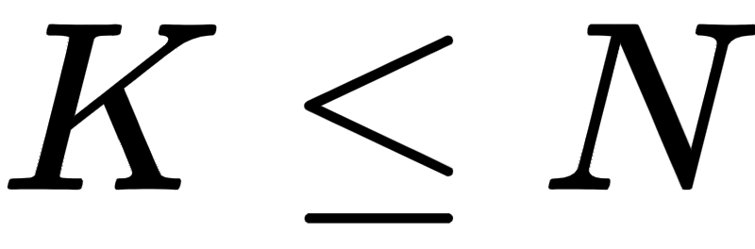
What happens when we relax the second condition and suppose we more generally have spanning vectors / basis elements?
Unsurprisingly we can no longer perfectly represent a generic set of P points in the space.
In N dimensions this set of K vectors can - at best - span a K dimensional subspace.

Slide 43
For example as illustrated in the figure below, if N=3 the best any set of K=2 spanning vectors can do is span a hyperplane.
A set consisting of a single K = 1 spanning vector can only span a line.
In both instances we clearly will not be able to perfectly represent all possible points in a space, since our reach in each case is restricted to a lower dimensional subspace of the full space.

Slide 44
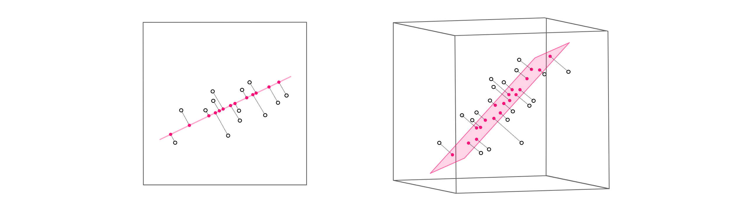
(left top) An example of data in N = 2 dimensions projected onto a K=1 dimensional subspace. (right top) An example of data projected in N = 3 dimensional space projected onto a K=2 dimensional subspace.

Slide 45
While we may not be able to perfectly represent a given point or set of points in the space, we can try our best.
Mirroring the setup we saw above with a complete basis, the same logic then leads us to the Least Squares cost function (a generalization of equation (4) above) for each data point
here the only difference from the original cost function is that we now only have K spanning set vectors.

Slide 46
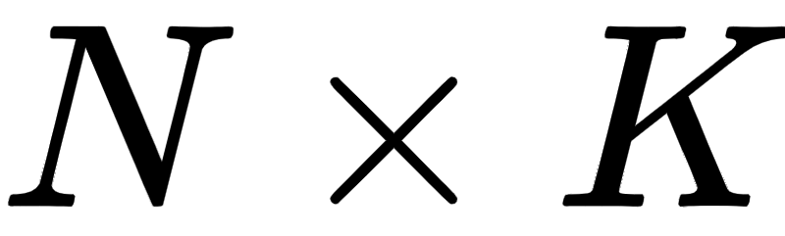
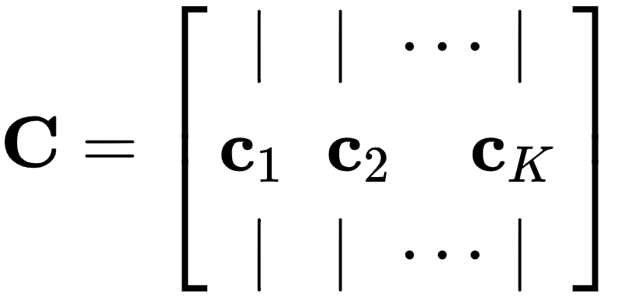
Likewise we can derive the similar looking first order system of symmetric equations providing our ideal weights or encoding vectors , writing them neatly using the compact vector / matrix notation established previously as
Here there is of course only one caveat: since we have only K spanning set vectors the matrix is , consisting of only our K spanning vectors lined up column-wise

Slide 47
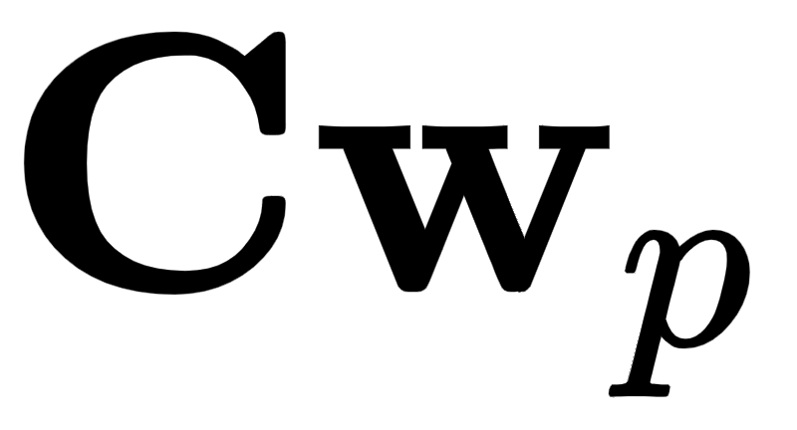
Note how once the weight vectors / encodings are computed the projection of
i.e., its representation over the subspace spanned by - is given by the formula .

Slide 48
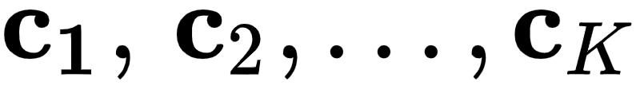
This is called the projection because the representation is given by 'dropping' perpendicularly onto the span of the hyperplane made by the span of the K basis elements.
In line with the same sort of 'coding' language often used to describe the weight vector as the encoding of a point in the (sub)space spanned by K spanning vectors
Which as we have seen (and as visualized in the figure above) - the projection of each point onto the subspace spanned by these K vectors is often referred to as the *decoding* of the original data point.

Slide 49
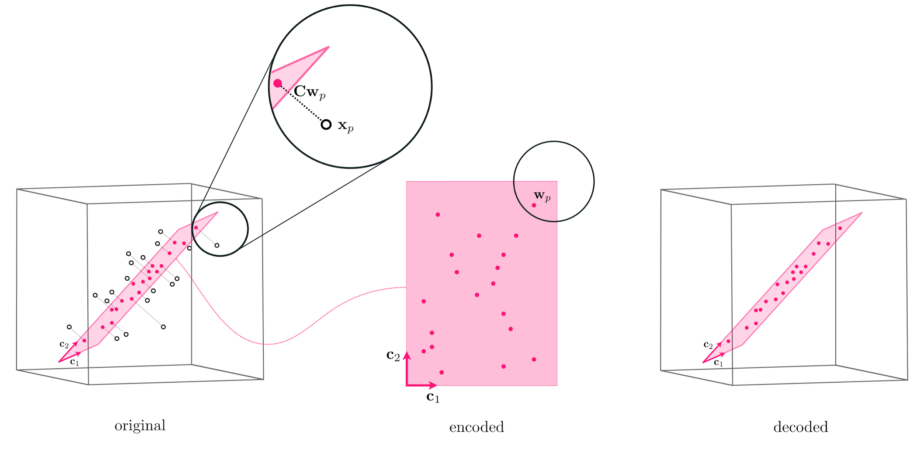

Slide 50
Imperfect representation using a fixed orthonormal spanning set

Slide 51
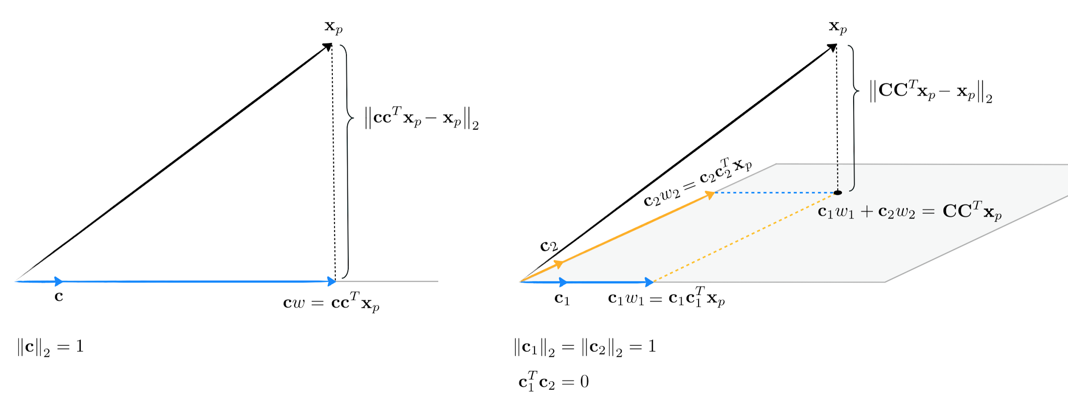
The geometry of projecting a point onto a basis of orthogonal vectors, shown when using K = 1 vectors in the left panel and K = 2 in the right.

Slide 52

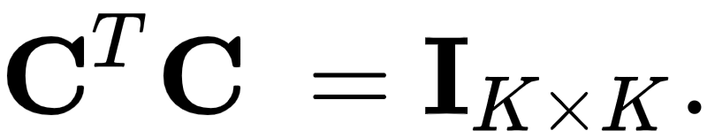
If our spanning set / basis of K elements is orthonormal the above formula for each weight vector encoding once again reduces algebraically to
since we will have

Slide 53
Our representation is likewise given simply in terms of the incomplete spanning set and datapoints as
These formula are absolutely critical since - as will see beginning in the very next Section...
...when we next aim to learn the best basis for a given set of data the assumption of orthogonality simplifies this learning process significantly.

